Slide 1
Hospitality Industry
Reservation system database

Slide 2
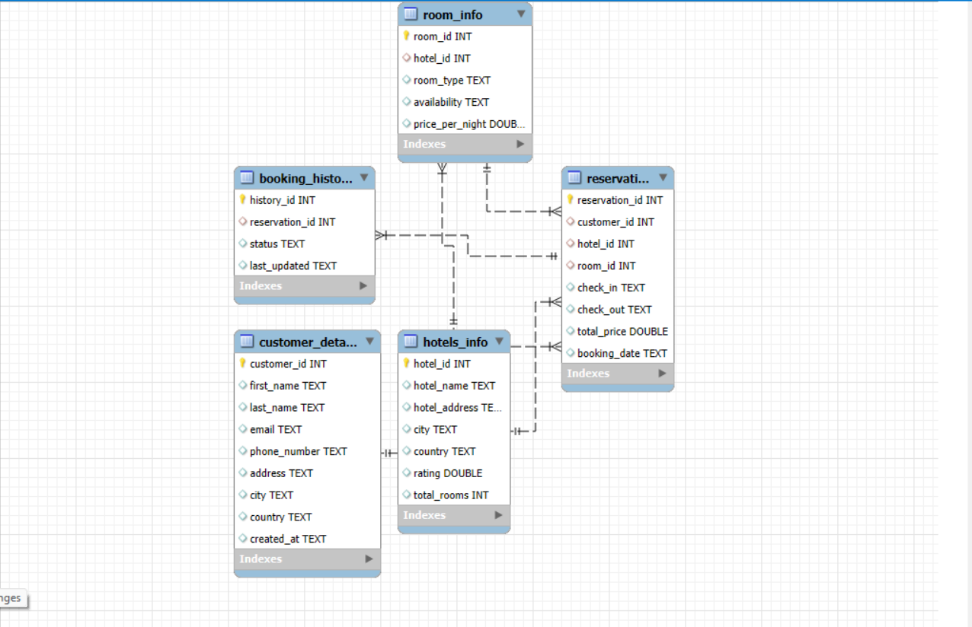
ER Diagram to understand overall structure of database

Slide 3
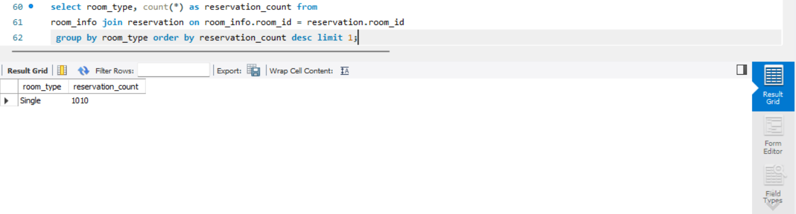
1] Find the most popular room type by reservation count ?

Slide 4
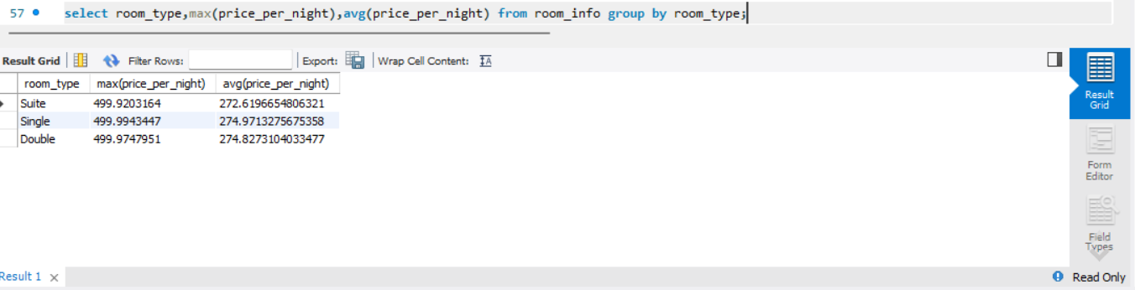
2] Find the Maximum and Average price per night of each room type ?

Slide 5
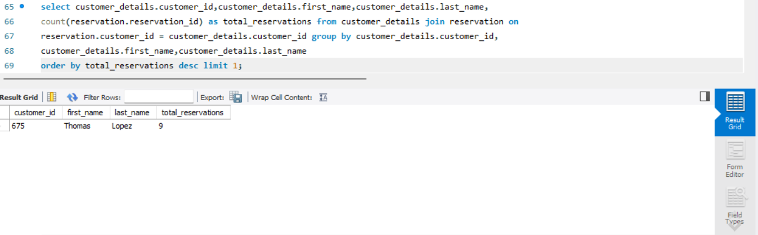
3] Find the first customer who has multiple reservations ?

Slide 6
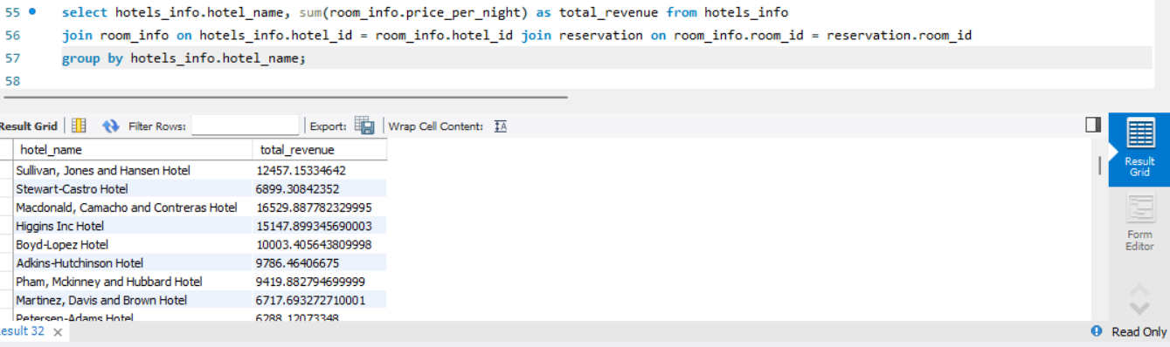
4] Find the total revenue generated by each hotel ?

Slide 7
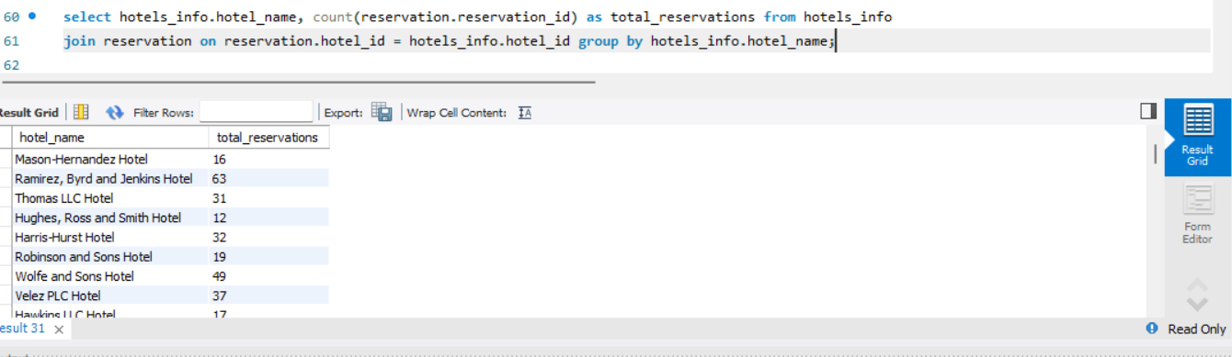
5] Find the total number of reservations for each hotel ?

Slide 8
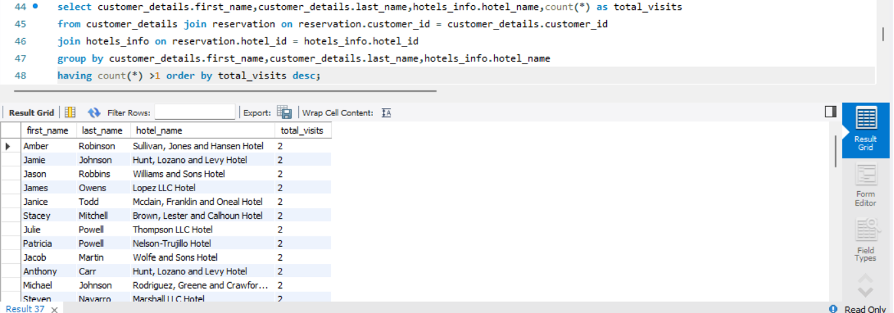
6] Find all customers who visits the hotel more than once ?

Slide 9
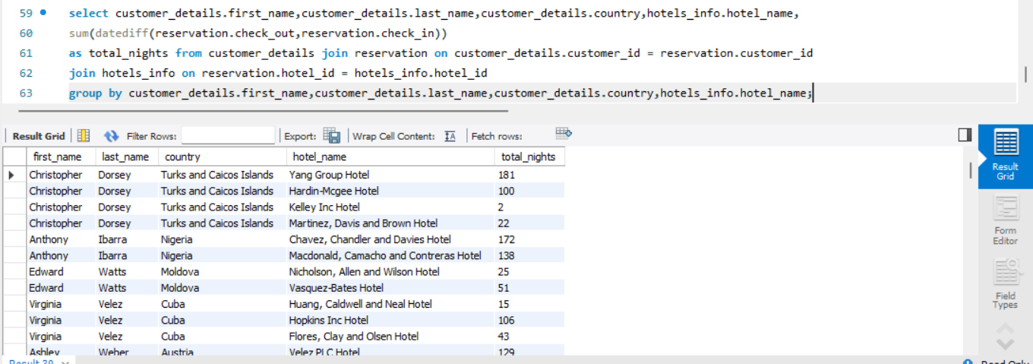
7] Find total nights booked by every customer ?

Slide 10
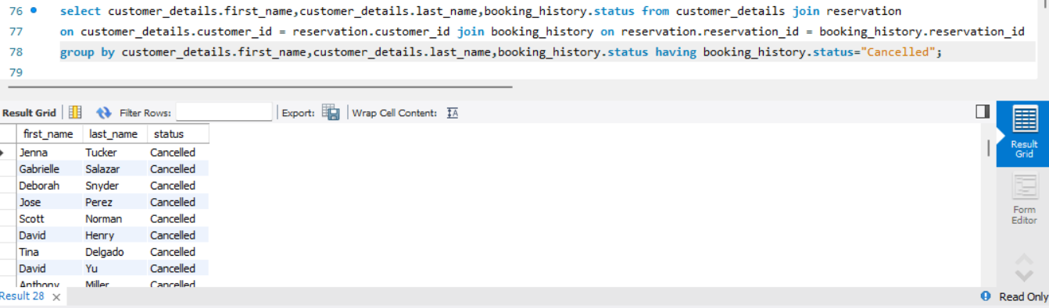
8] Find all customers who cancelled their bookings ?

Slide 11
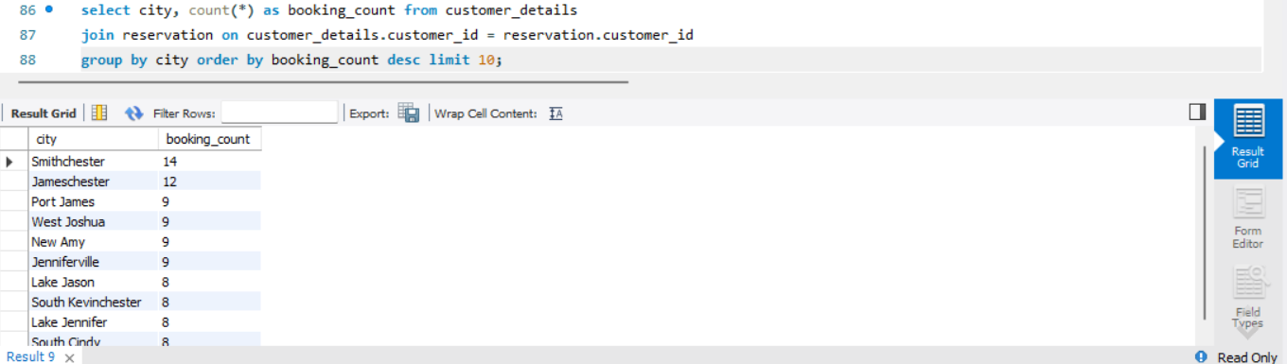
9] Find the top 10 cities from where highest number of bookings has been done ?

Slide 12
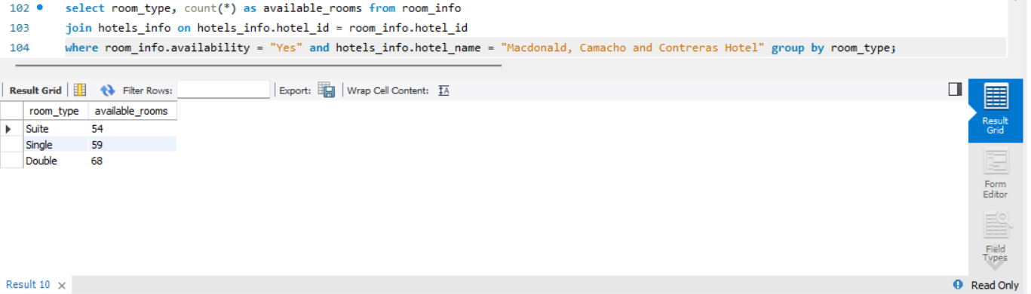
10] Find the total available rooms from ‘ Macdonald, Camacho and Contreras Hotel ’ in each room type ?

Slide 13
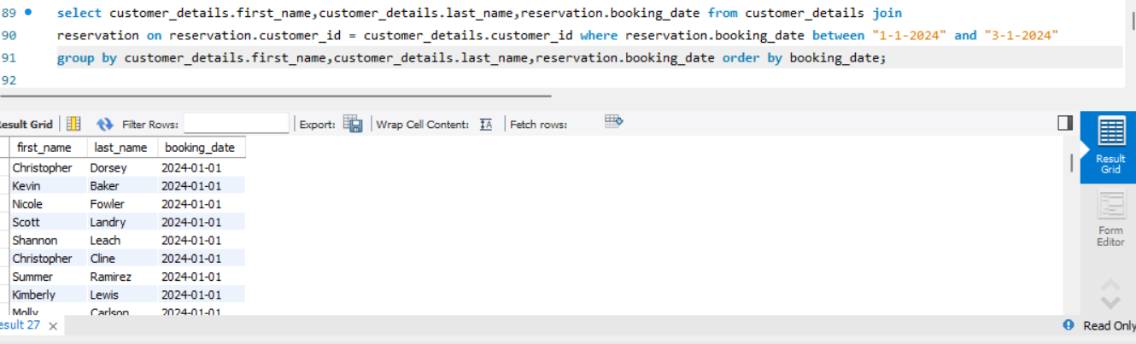
11] Find the customers who booked the room between ‘1/1/2024 to 3/1/2024 ’date ?

Slide 14
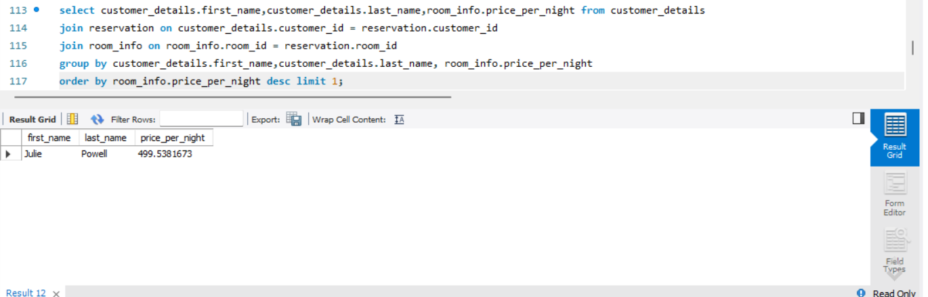
12] Find the customer who booked room by paying the highest price per night ?

Slide 15
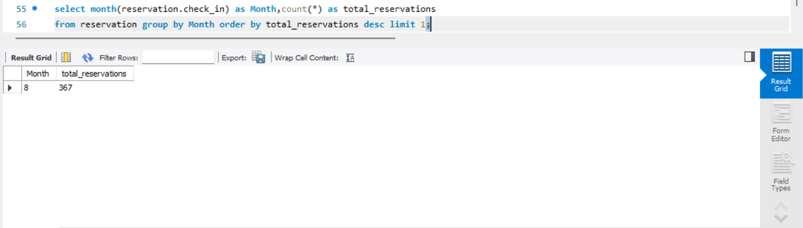
13] Find the busiest month for reservation ?

Slide 16
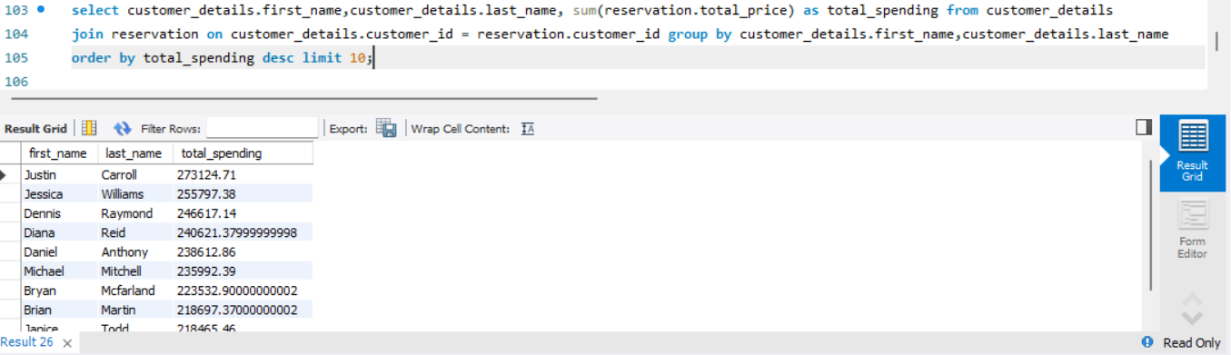
14] Find the top 10 customers based on total spending ?

Slide 17
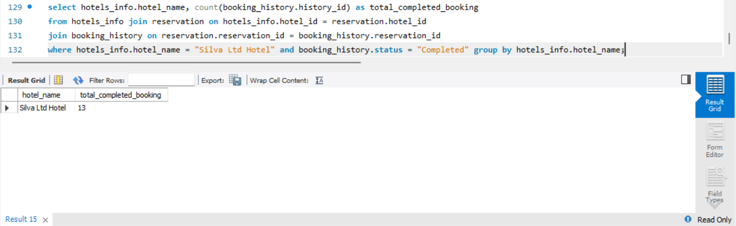
15] Show the total completed bookings from ‘ Silva Ltd Hotel ’ ?

